Slide 1
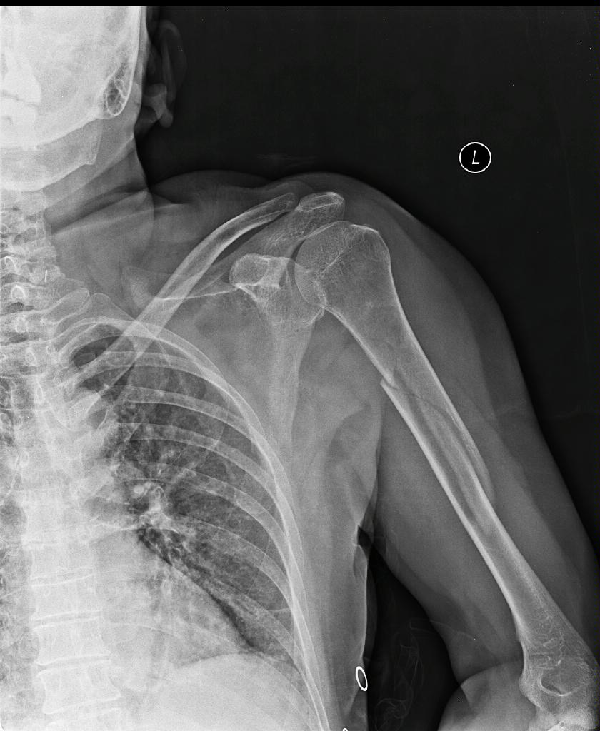
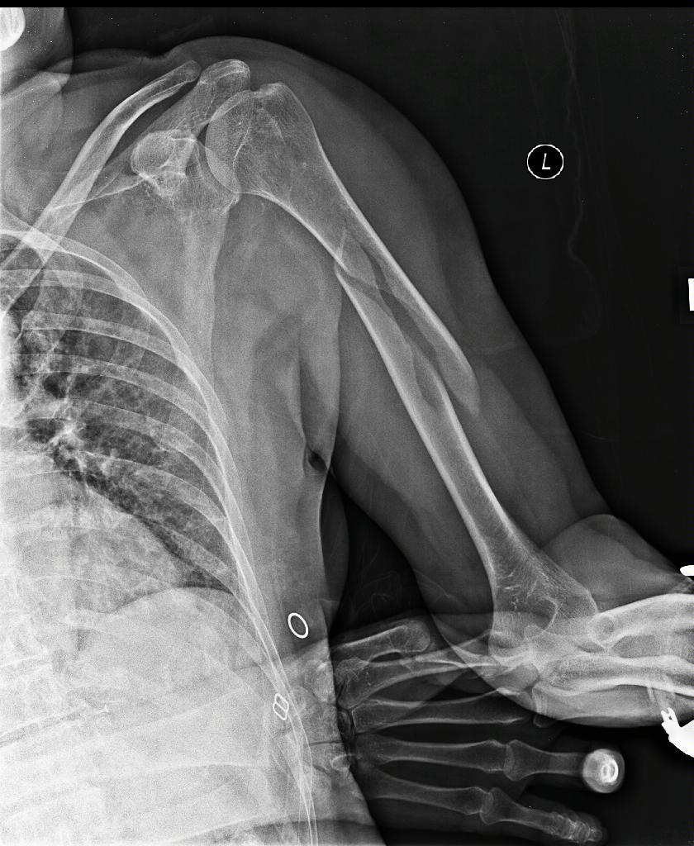
06/08/2016
06/08/2016
DOB:15/09/1944. Age 72 ears old. Very active. Has three sons one Orthopaedic surgeon in Athens,
one Neurosurgeon and one vascular surgeon. A very functional and comfortable U-slab was applied at that stage.

Slide 2
DOB:15/09/1944. Age 72 ears old.
Very active.
Has three sons one Orthopaedic surgeon in Athens, one Neurosurgeon and one vascular surgeon.
A very functional and comfortable U-slab was applied at that stage.

Slide 3
She wants good use of her arm / hand straightaway
She doesn’t want to keep a U-slab and sling for 6 to 8 weeks.

Slide 4
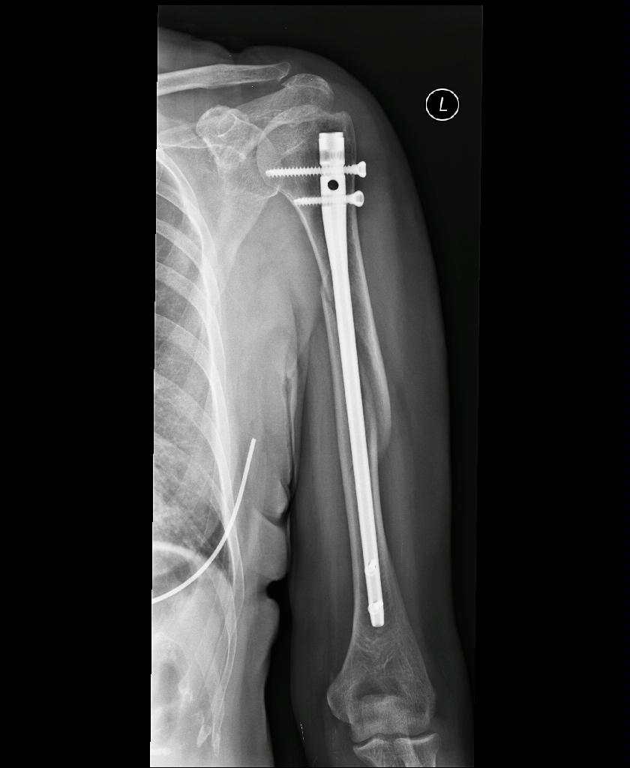
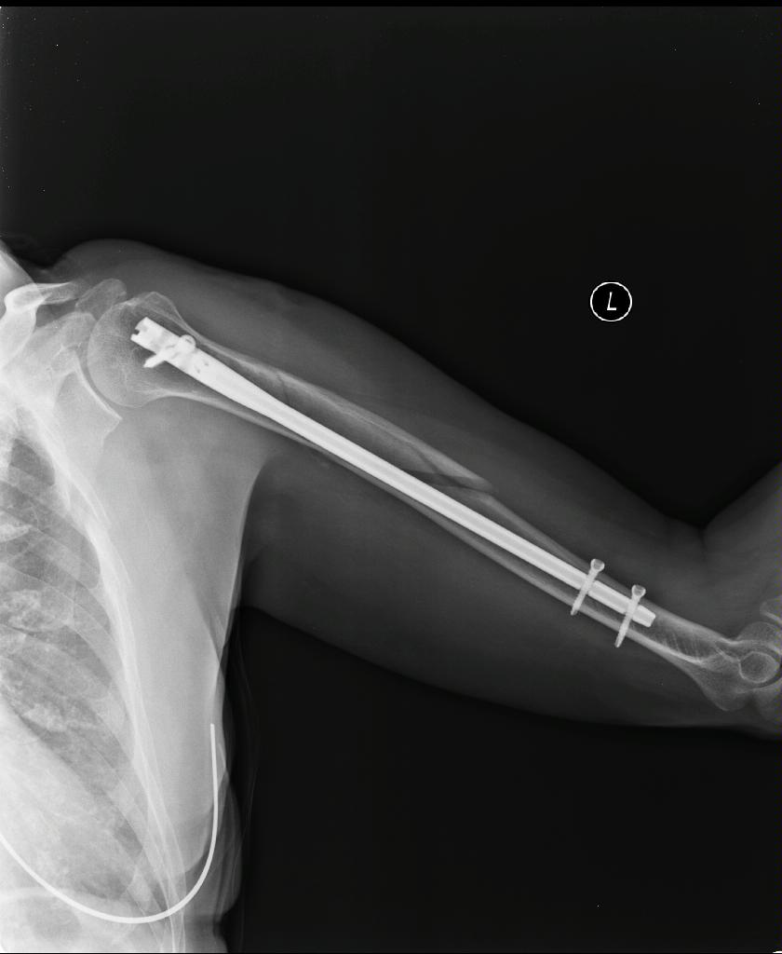

Slide 5
