Slide 1
CURRENT CONCEPTS IN TREATMENT & REHABILITATION OF KNEE PROBLEMS
Advances in Arthroscopic surgery. Importance of the communication with the Physiotherapist. Return to Sports.
.
Hadjichristofis Stelios FCS(SA)Orth. / Mmed(WITS)Orth.

Slide 2
CURRENT CONCEPTS IN TREATMENT & REHABILITATION OF KNEE PROBLEMS
Main Knee problems
Anatomy
Diagnostic tips
Advances in surgery
Return to sports
Rehabilitation

Slide 3
The six main categories of knee problems

Slide 4
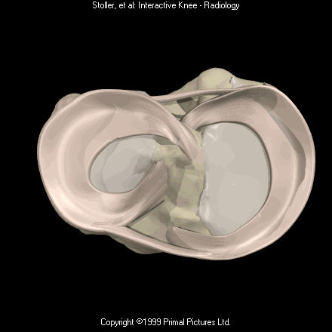
Anatomy of the menisci L P M
Lateral
Medial

Slide 5
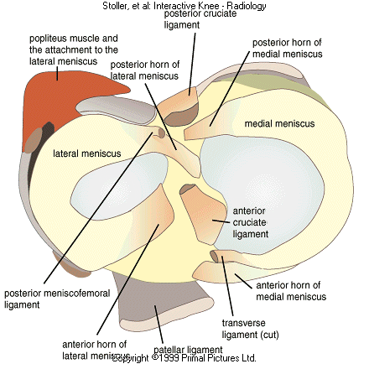
Right knee joint and menisci from above

Slide 6
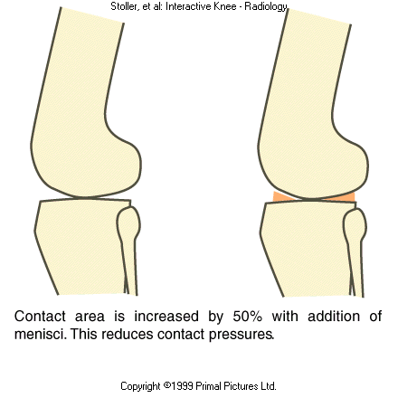
Meniscal biomechanics and functional anatomy – greater comformity

Slide 7
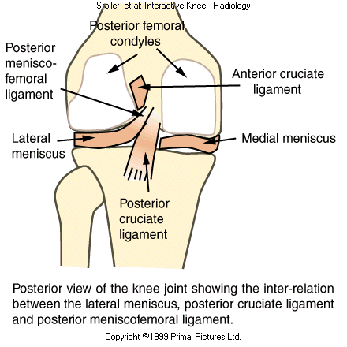
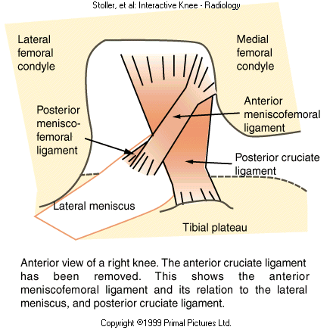
Meniscofemoral ligaments
Increase stability of knee joint

Slide 8
Menisci increase stability of the knee joint

Slide 9
Functions of the meniscus
Findings after Total Meniscectomy:
 joint space narrowing
 osteophyte formation
 squaring of the femoral condyles
Meniscus is important in joint protection

Slide 10
Functions of the meniscus
ACL deficient knee
 The posterior horn of the medial meniscus is the most important structure resisting an applied anterior Tibial force

Slide 11
Functions of the meniscus
Removal of the medial meniscus :
50 % to 70% ↓ in femoral condyle contact area
100% ↑ in contact stress
Total lateral meniscectomy:
40% to 50% ↓ in contact area
200% to 300% ↑ contact stress in the lateral compartment

Slide 12
Functions of the meniscus
Important in many aspects of knee function
 Load sharing
 Shock absorption
 Reduction in joint contact stresses
 Passive stabilization
 Increasing congruity and contact area
 Enhancing joint stability
 Limitation of extremes of flexion and
extension
 Proprioception

Slide 13
Meniscus - Basic science
Blood supply and Neuroanatomy
◈ At birth entire meniscus is vascular
◈ At 9 months inner 1/3 avascular
◈ 10 years resembles adult meniscus
◈ Adult – Lateral : outer 10% to 20%
- Medial: outer 10% to 30%

Slide 14
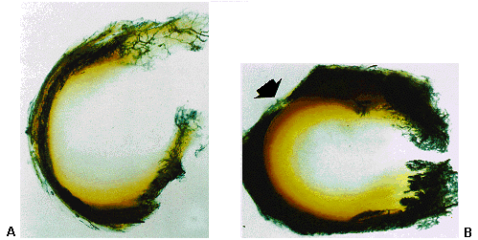
Blood supply of the menisci
Medial
Lateral

Slide 15
Epidemiology
Meniscal tears
Mean annual incidence – 60 to 70 per
100000
 M:F ratio ranges from 2.5 to 4.1
 Degenerative tears 40-60
 ACL injury – Acute : Lat > Med
- Chronic : Med > Lat
Tibial plateau fracture-frequent up to 47%

Slide 16
Meniscal injury
 Injury to the meniscus from:
- athletic events
- activities of daily living
 Arthroscopic treatment
- One of the most common Orth
Surgical procedures
- 10% to 20% of all surgeries in
many centers.

Slide 17
Classification of Meniscal tears
Two etiologic categories:
1. Excessive application of force to a normal meniscus.
2. Normal forces acting on a degenerative.
structure.

Slide 18
Classification of Meniscal tears
Patterns of meniscal tear
 Longitudinal tears
- complete (ie,bucket handle tears)
- incomplete
- oblique
 Complex or degenerative tears
 Transverse (radial) tears
 Horizontal

Slide 19
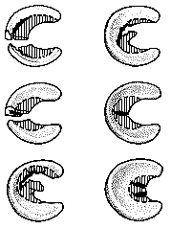
Classification Meniscal tears

Slide 20
Meniscal injury
Clinical symptoms:
 Pain
 Swelling
 Locking
 Catching
 Loss of motion
Often require surgical intervention

Slide 21
Meniscal injury
Accurate preoperative diagnosis
Primary methods :
 History
 Physical examination
 Plain radiographs
 MRI

Slide 22
Meniscal injury - Diagnosis
History
 Patient age
 Mechanism of injury
 Onset of symptoms
 Complaints – locking or catching
- loss of motion
 Degenerative tears - ⟩ 40 years

Slide 23
Meniscal injury - Diagnosis
Physical examination
 Inspection – joint effusion;qudriceps m.
atrophy;any joint line swelling.
 Range of motion
 Palpation
 Specialized tests – joint line palpation
- flexion McMurry test
- Apley grind test

Slide 24
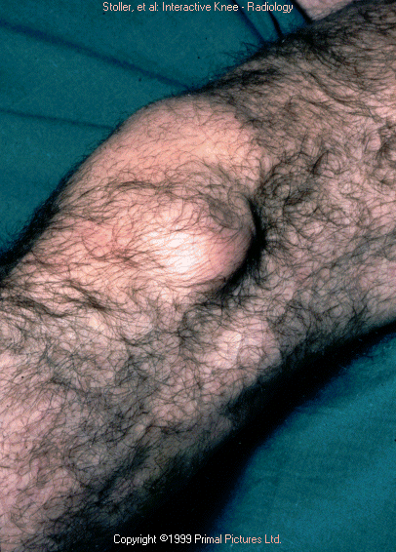
Clinical presentation of meniscal cyst
Meniscal Cyst

Slide 25
History, Clinical findings, magnetic resonance imaging, and arthroscopic correlation in Meniscal injuries
Clinical tests to detect Meniscal injury
Joint line tenderness
McMurry test
Apley test
Stienmann test
Payr’s test
Children’s sign (Squat test
Ege’s test

Slide 26
History, Clinical findings, magnetic resonance imaging, and arthroscopic correlation in Meniscal injuries
Clinical examination performed by an experienced knee surgeon had better :
specificity (90% vs 60%),
Positive predictive value (95% vs 83%),
Negative predictive value (90% vs 86%) and
diagnostic accuracy (93% vs 83%)
Clinical examination by an experienced examiner using multiple meniscus tests is sufficient for a diagnosis of a meniscal tear.
Knee Surg Traumatol Arthrosc (2012) 20:851-856

Slide 27
In statistics and diagnostic testing, the positive predictive value, or precision rate is the proportion of positive test results that are true positives (such as correct diagnoses
In statistics and diagnostic testing, the negative predictive value (NPV) is a summary statistic used to describe the performance of a diagnostic testing procedure. It is defined as the proportion of subjects with a negative test result who are correctly diagnosed

Slide 28
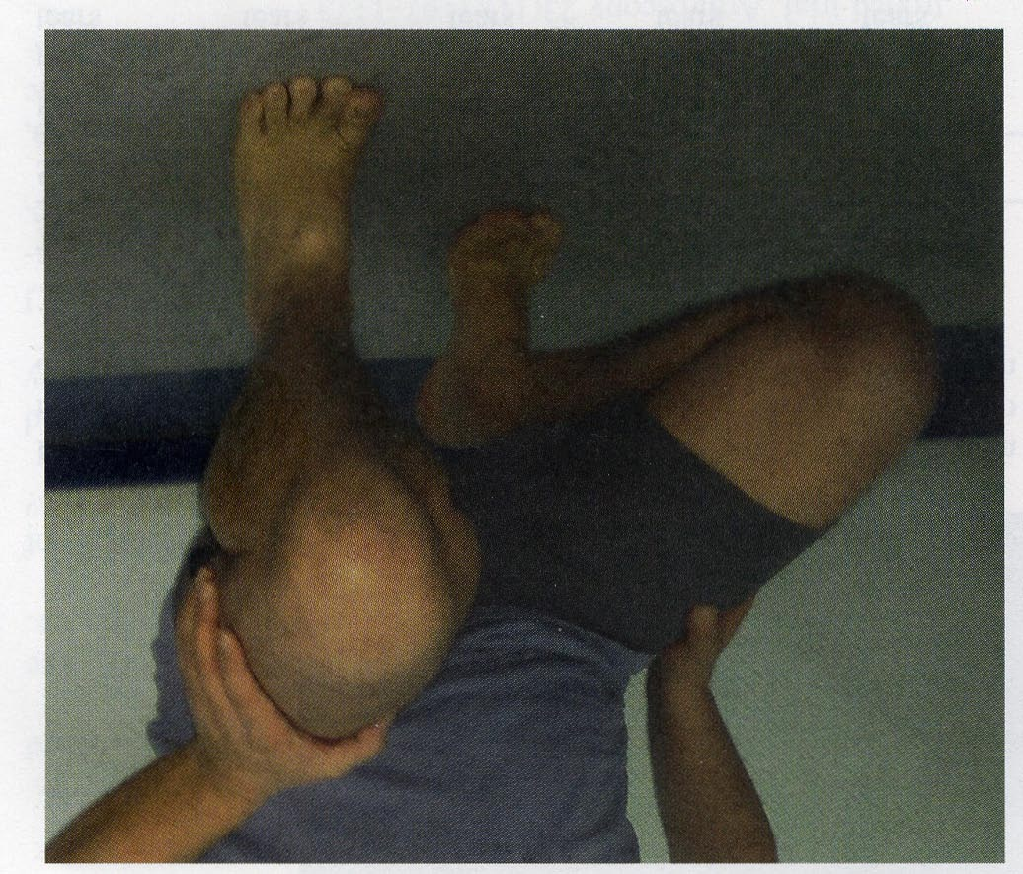
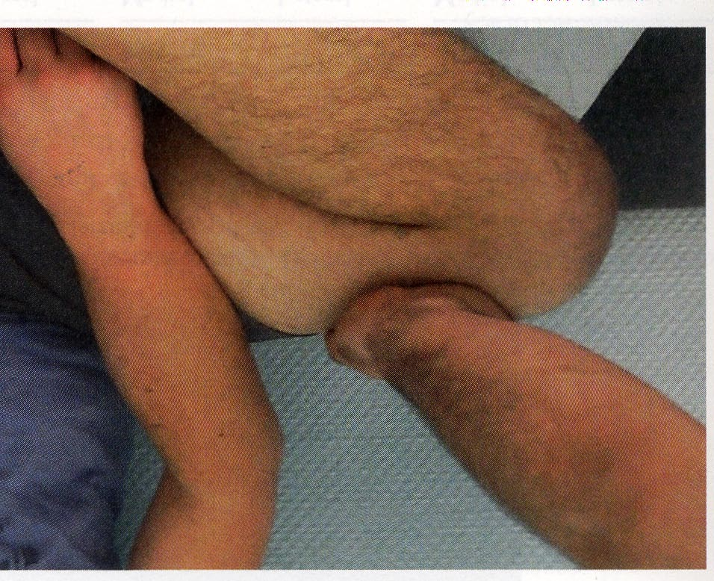
Children’s sign (squat test)
Payr’s test

Slide 29
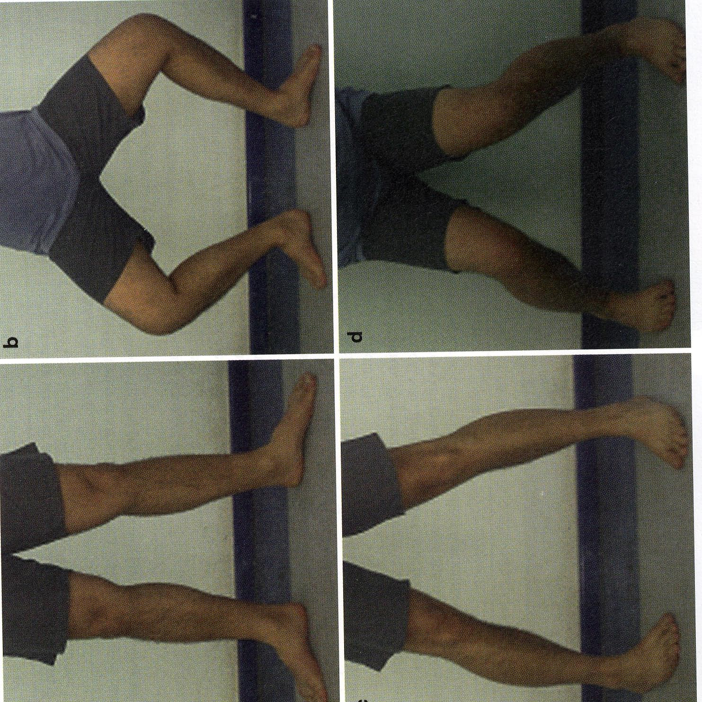
Ege’s test
→ Medial meniscus
→ Lateral meniscus

Slide 30
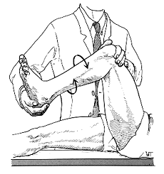
McMurry test

Slide 31
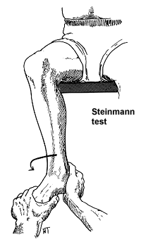
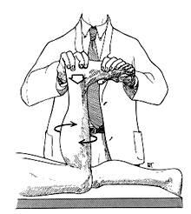
Steinman test
Apleys test

Slide 32
Meniscal injury - Diagnosis
Specialized tests
 Joint line tenderness- best clinical sign
of meniscal tear;74% sens and 50% +ve
predictive value
 Flexion McMurry test- Spec. 90% to 98%
and sens. 30% to 50%.
 Apley grind test
Clinical evaluation overall
Medial Meniscus - Sens 95%; Spec. 72%;+ve
pred. Value 85%
Lateral Meniscus –Sens.88%; Spec 72% ; +ve
Pred value58%

Slide 33
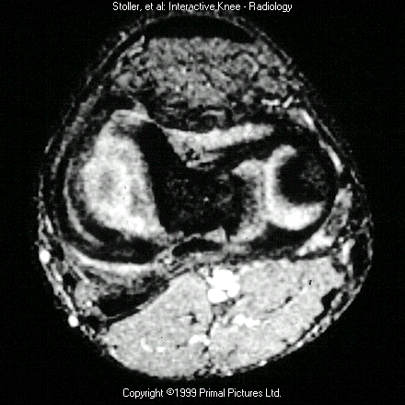
MRI presentation of longitudinal meniscal tear

Slide 34
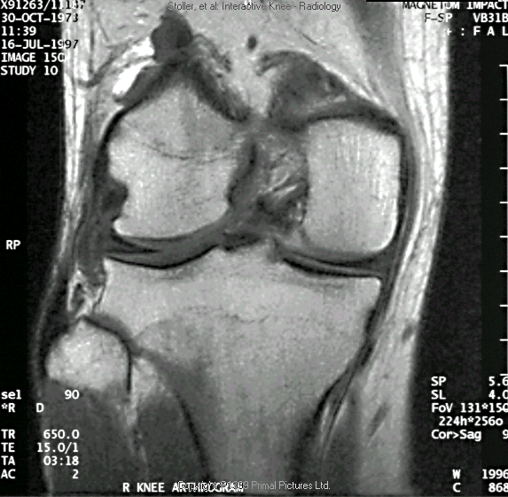
Horizontal cleavage tear (MRI)

Slide 35
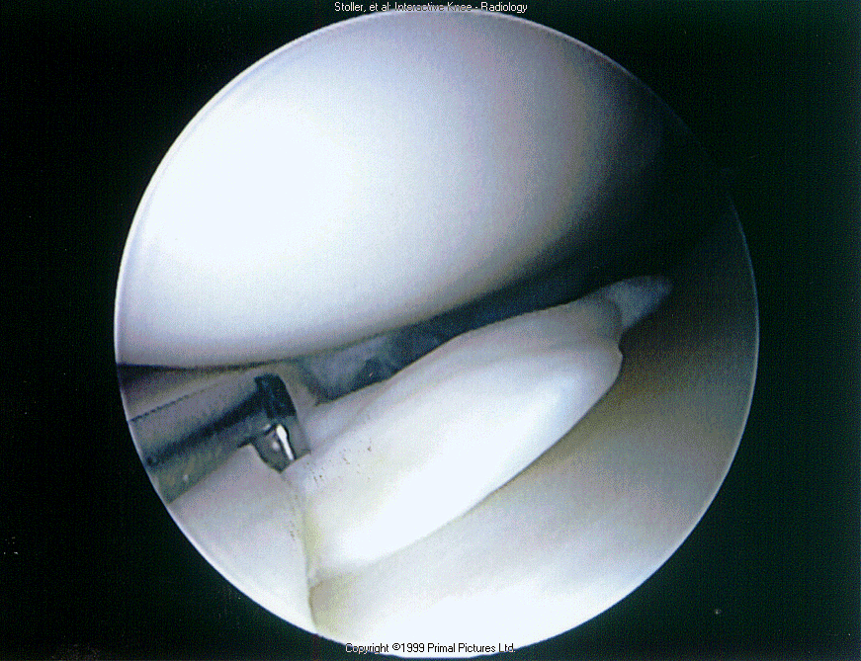
Typical flap tear of the medial meniscus

Slide 36
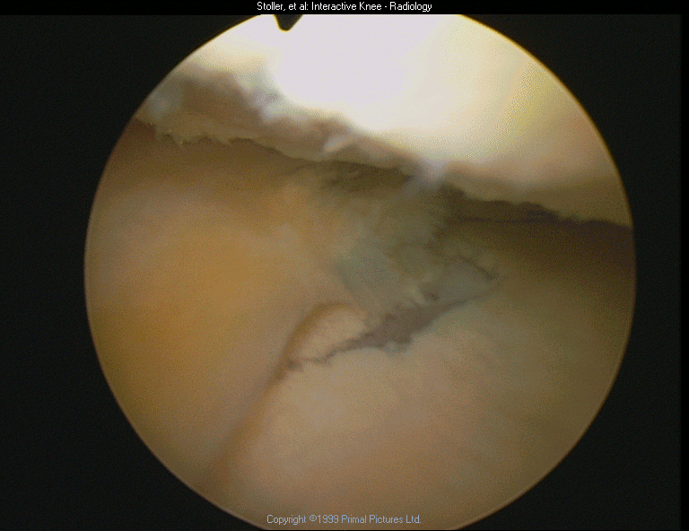
Medial compartment Osteoartritis

Slide 37
Meniscal injuries
Are meniscectomies still indicated ?
➢ Meniscal reparability
➢ Why repair the meniscus
➢ Meniscal repair techniques
➢ Short term outcomes of partial
meniscectomies
➢ Long terms outcomes of partial
meniscectomies

Slide 38
Meniscal Repair
Meniscal Repair Indications
 Factors:
➢ Patient age
➢ Chronicity
➢ Location -Type of tear
➢ Associated ligamentous instability
Ideal candidate: Young patient with an acute peripheral tear 1-2 cm in length - (ACL).

Slide 39
Meniscal Repair
Meniscal Repair Techniques
➢ Open
➢ Arthroscopic : > Inside-out
> Outside-in
> All inside
> Non suture technique
> Hybrid suture
technique
➢ Meniscal repair enhancement –
Fibrin clot collagen scaffold substance

Slide 40
Surgical Treatment
Criteria for meniscal repair include:
(1) a complete vertical longitudinal tear >10 mm long;
(2) a tear within the peripheral 10% to 30% of the meniscus or within 3 or 4 mm of the meniscocapsular junction;
(3) a tear that can be displaced by probing, thus demonstrating instability;
(4) a tear without secondary degeneration or deformity;
(5) a tear in an active patient; and
(6) a tear associated with concurrent ligament stabilization or in a ligamentously stable knee.

Slide 41
Surgical Decision Making
Surgical indications for Arthroscopic Treatment
(1) symptoms of meniscal injury that affect activities of daily living, work, and/or sports;
(2) positive physical findings of joint line tenderness, joint effusion, limitation of motion, and provocative signs, such as pain with squatting or a positive flexion McMurray or Apley grind test;
(3) failure to respond to nonsurgical treatment, including activity modification, medication, and a rehabilitation program; and
(4) absence of other causes of knee pain identified on plain radiographs or other imaging studies.

Slide 42
Meniscal absorbable arrows

Slide 43
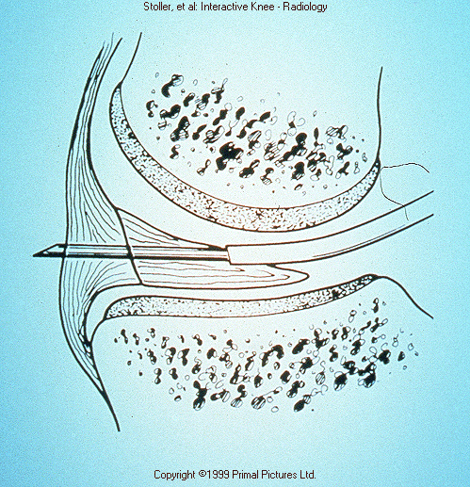
All-inside technique of suturing the meniscus(T-fix)

Slide 44
Meniscal Repair
Conclusions – meniscal repair
➢ Even though the rate of failure in avascular, complex meniscal repairs than that reported for peripheral repairs, we believe the benefits of a potentially functional meniscus outweigh the risks of reoperation in athletically active young patient.

Slide 45
Meniscal Repair
Conclusions – meniscal repair
➢ Early diagnosis and repair before extensive stractural damage occurs
➢ Most not repairable because of the chronicity of
the problem
➢ Partial meniscectomies – very frequent
➢ Careful partial meniscectomy – satisfactory outcome

Slide 46
Nearly three quarters of anterior cruciate ligament (ACL) injuries are noncontact injuries.
Female athletes have been reported to sustain noncontact ACL injuries at a rate two to eightfold greater than their male counterparts

Slide 47
Meniscus Repair
Rehabilitation of the knee following
meniscus repair in conjunction
with an ACL reconstruction is similar
to the regimen for isolated meniscus
repair, with one exception:
To prevent the problem of arthrofibrosis
and loss of motion, it is imperative that knee motion be begun immediately in order to achieve full range of motion.

Slide 48
Partial tear of ACL
MR diagnosis of partial ACL tear is difficult because various tear patterns may be seen.
Many partial tears demonstrate MR features that are indistinguishable from complete ACL tear, mucoid ACL degeneration or normal ACL
Radiologists should be descriptive in reporting on MR of ACL tears alerting the clinician to the possibility of partial tear.
Knee Surg Sports traumatol Arthrosc(2012-Feb) 20:256-261.

Slide 49
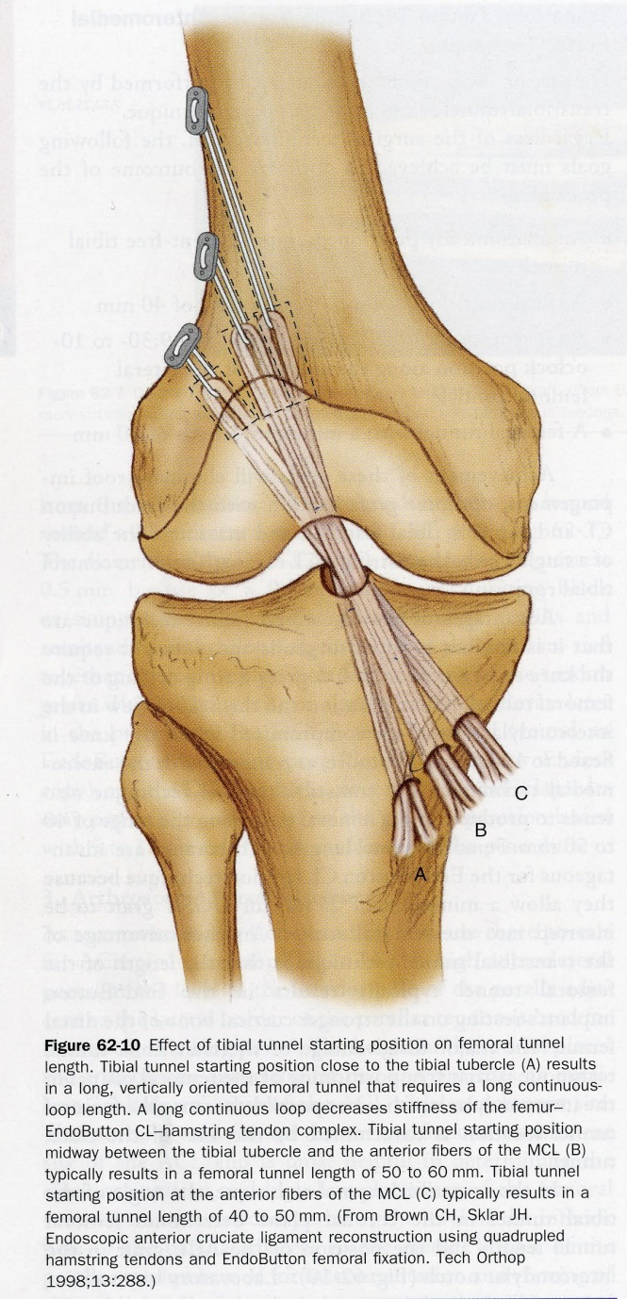
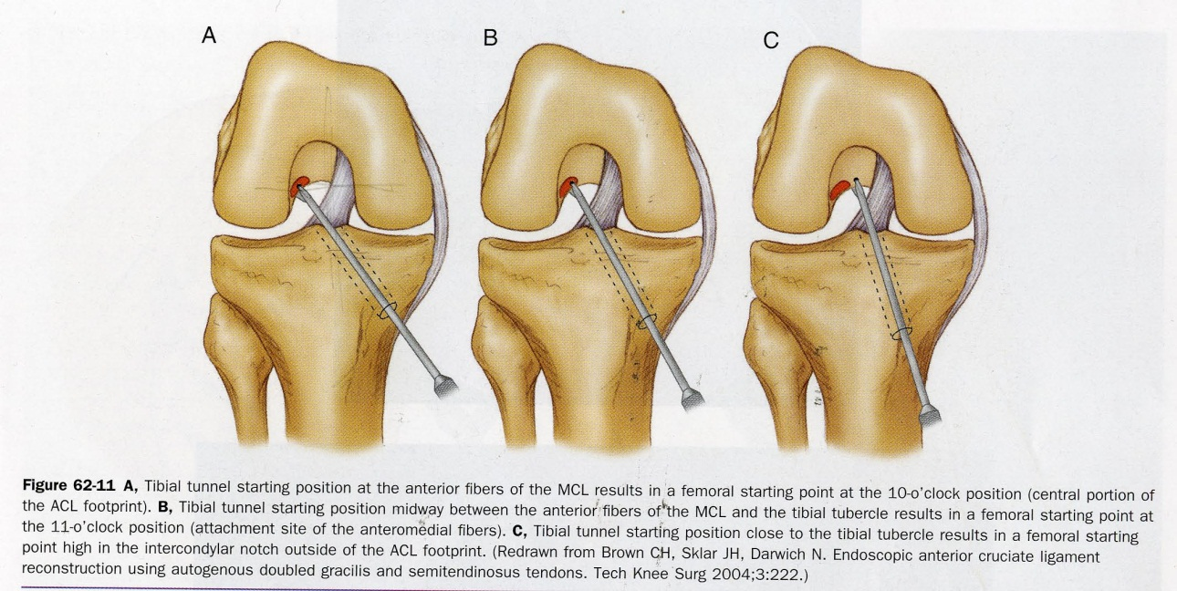

Slide 50
Single-bundle reconstruction
Proven success
Greater technical ease
Less tunnel widening
Fewer complications
Easier revision
Lower graft cost for surgeons
using allograft ($1,800 to $3,000less)
Lower implant cost
Shorter surgical time
Advantages of Single - Versus - Double-bundle Reconstruction
Double-bundle reconstruction
Greater rotatory stability
More normal knee kinematics34

Slide 51
Advantages of Autograft and Allograft
Autograft
Higher normal stability rate and
lower graft failure rate 1
Lower infection rate 2
No risk of disease transmission
No risk of immune reaction3
Lower cost 4
Faster graft incorporation/faster
return to full activities5
Allograft
Faster immediate postoperative recovery
Less postoperative pain
Graft harvest not part of surgery
No donor site morbidity
Larger grafts available for
double-bundle reconstruction
Improved cosmesis

Slide 52
Controversies in Soft-tissue Anterior Cruciate Ligament Reconstruction: Grafts , Bundles, Tunnels, Fixation , and Harvest
Increased stability has been reported with both autografts and
allografts for anterior cruciate ligament (ACL) reconstruction.
However, meta-analysis has shown significantly lower overall knee
stability rates and more than double the abnormal stability rate
with allografts. Some issues surrounding allograft sterilization (ie,
risk of disease transmission) are unresolved, and cost is also a concern.
Single-bundle ACL reconstruction can produce high stability
rates when tunnels are properly placed, but there is evidence that
Double-bundle repair may offer greater rotatory stability.
Cortical fixation has been associated with increased stability owing to the
high stiffness of cortical bone. Anterior and posterior approaches
are both recommended. The controversy related to single-bundle
versus double-bundle ACL reconstruction remains unresolved
J Am Acad Orthop Surg 2008;16:376-384Copyright 2008 by the AmericanAcademy of Orthopaedic Surgeons.
Chadwick C. Prodromos, MDFreddie H. Fu, MDStephen M. Howell, MD

Slide 53
Surgery for ACL deficiency in patients over 50
Age itself – not a contraindication for ACL surgery
Physiological age
Condition of the knee at the time of examination
Expectancy of life
Activity level :
More important that chronological age
ACL Reconstruction is indicated to manage ACL-related secondary injury and prevent further lesions
Knee Surg.Traumatol Arthrosc (2011) 19:412-417

Slide 54
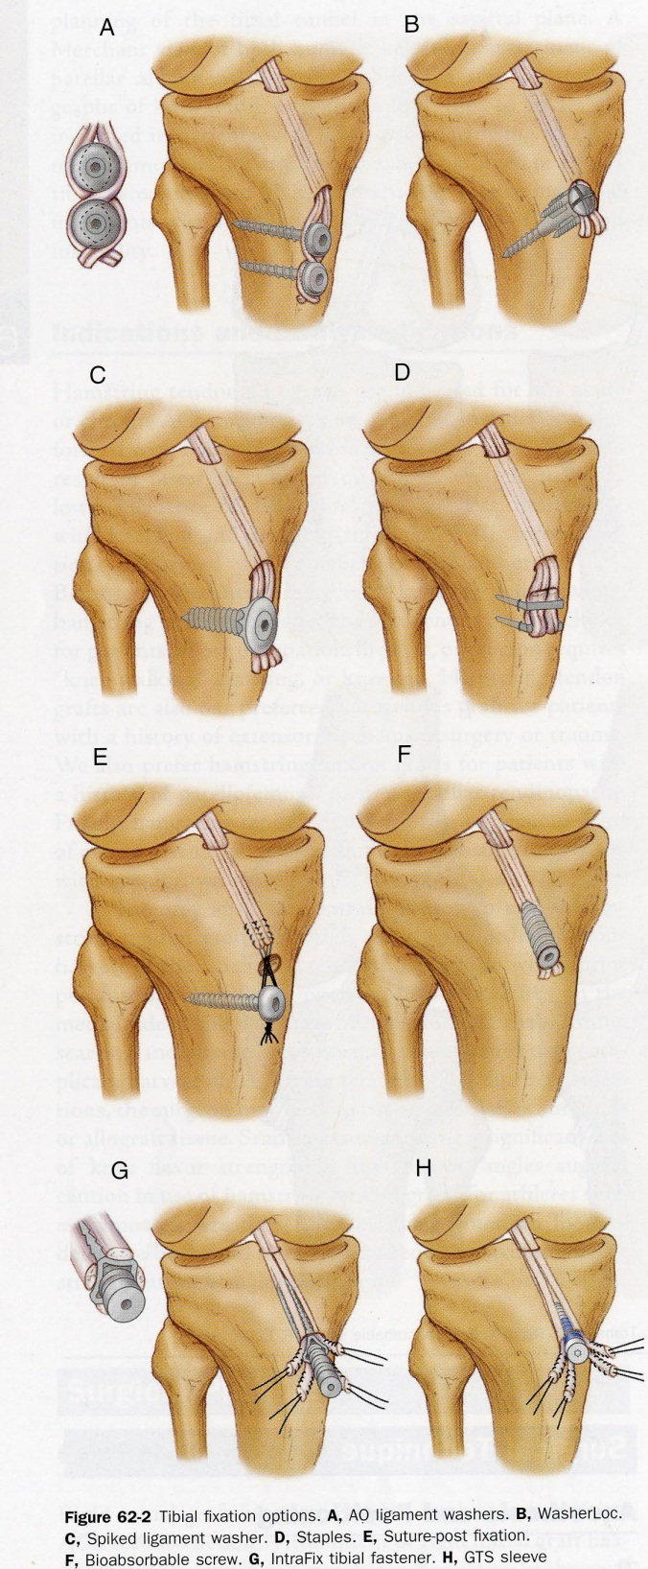
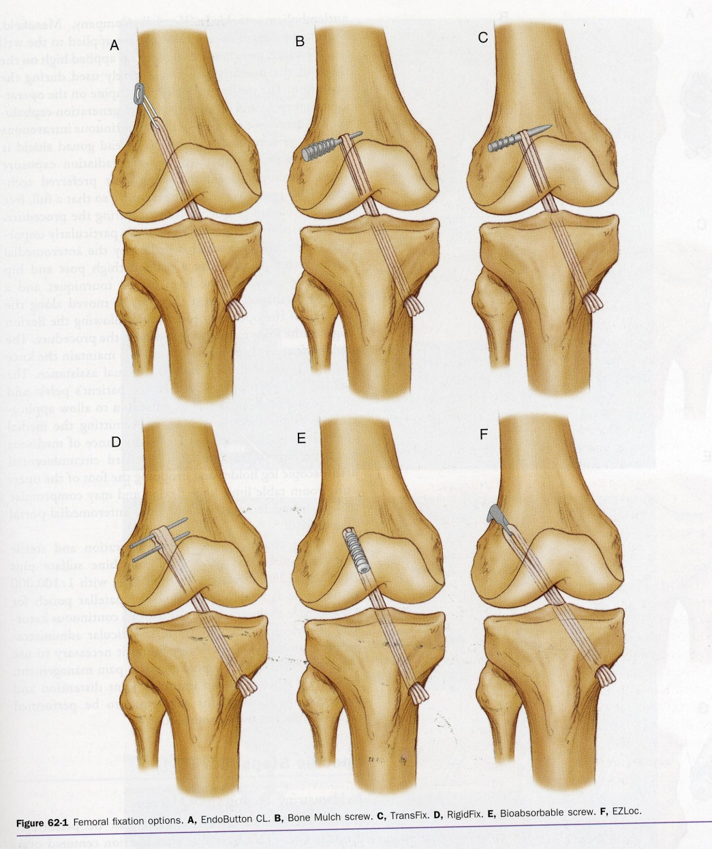

Slide 55
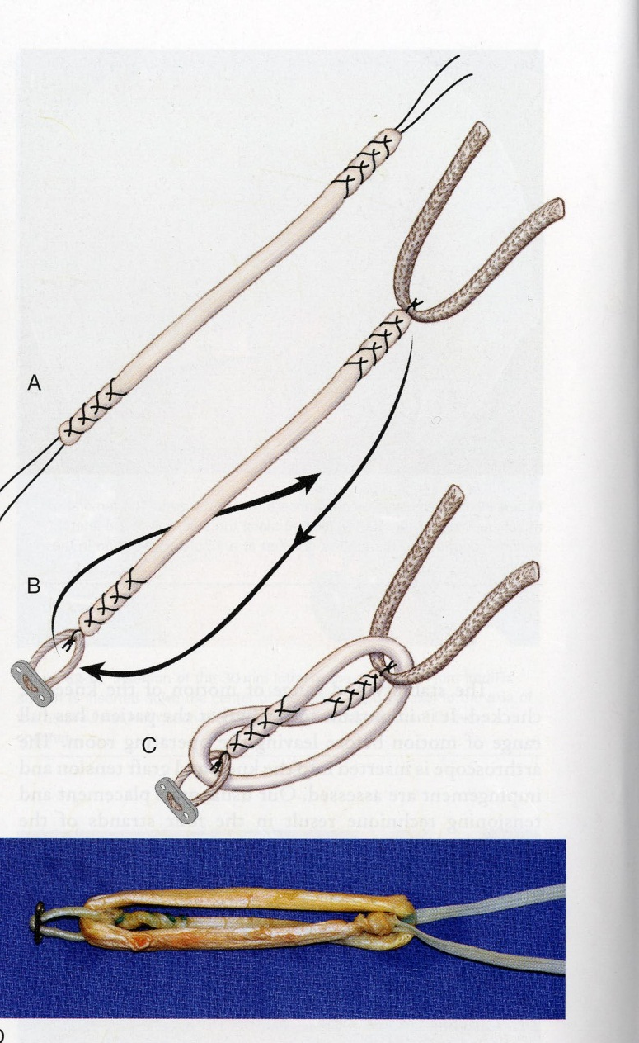
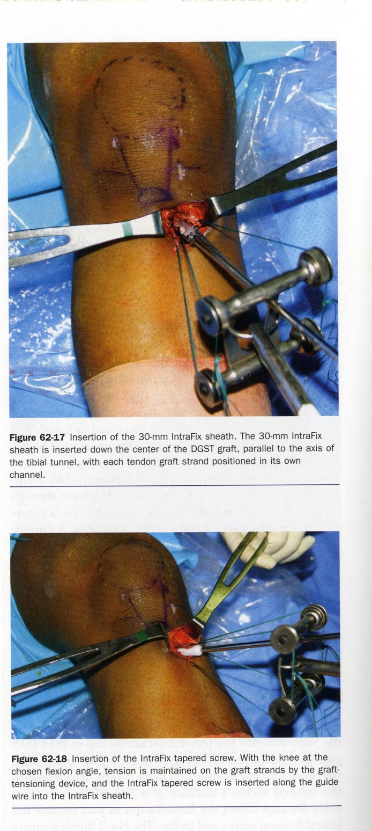
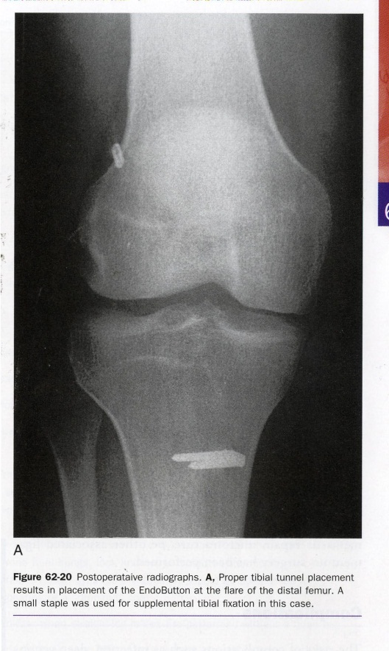

Slide 56
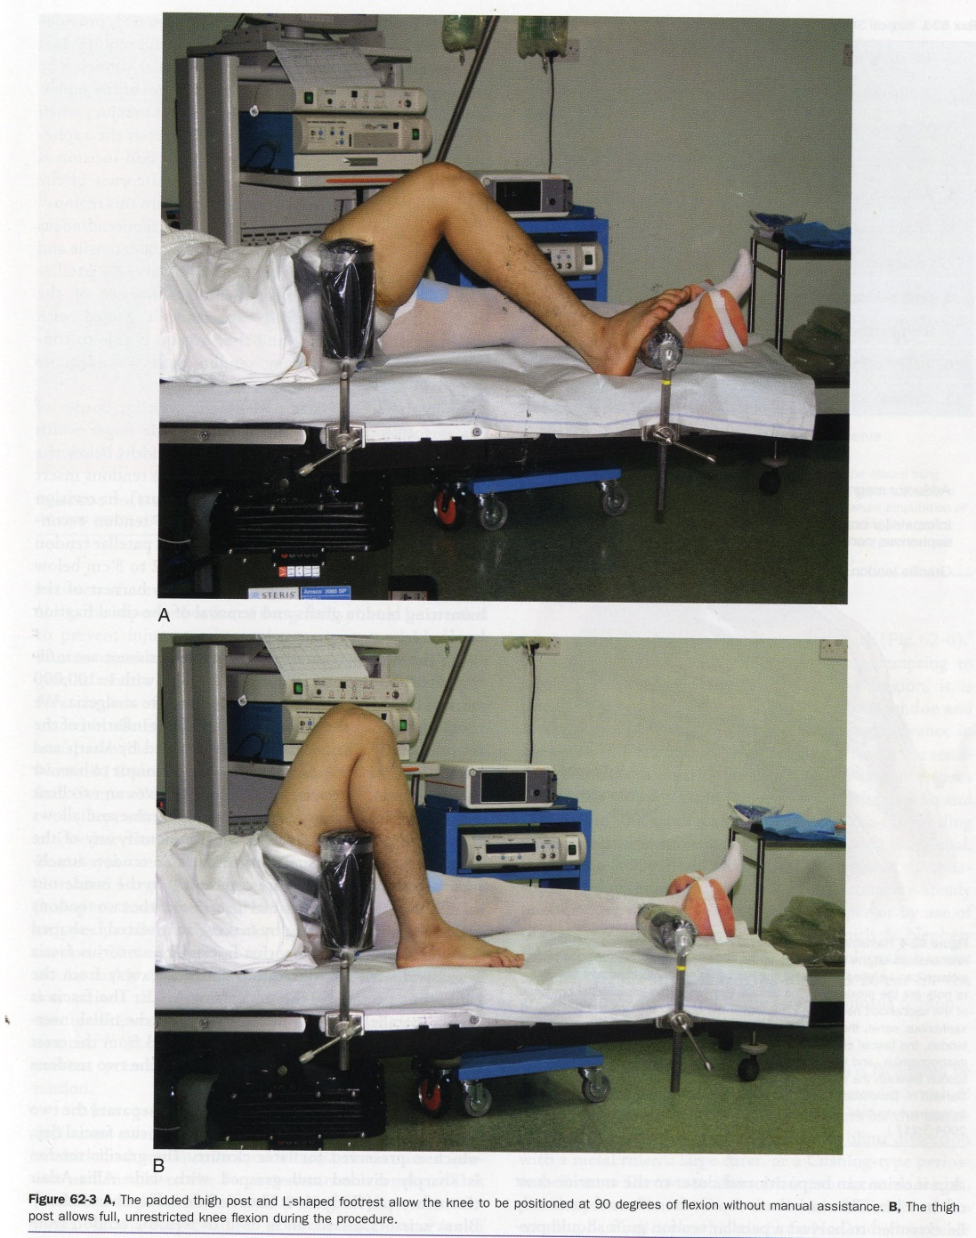
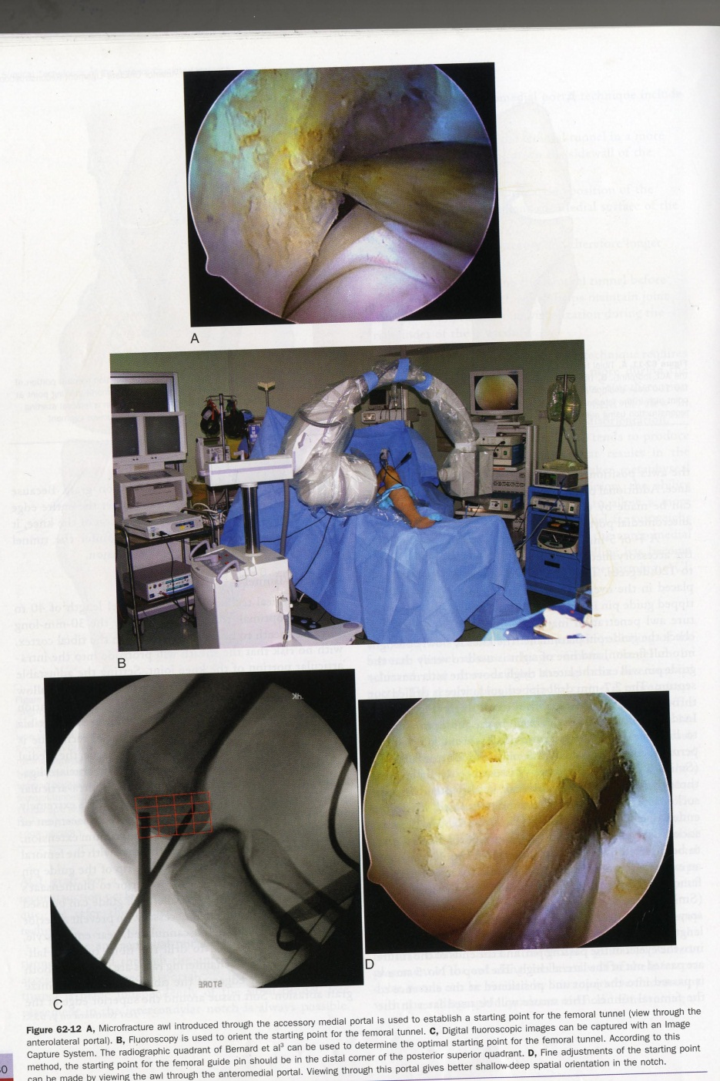

Slide 57
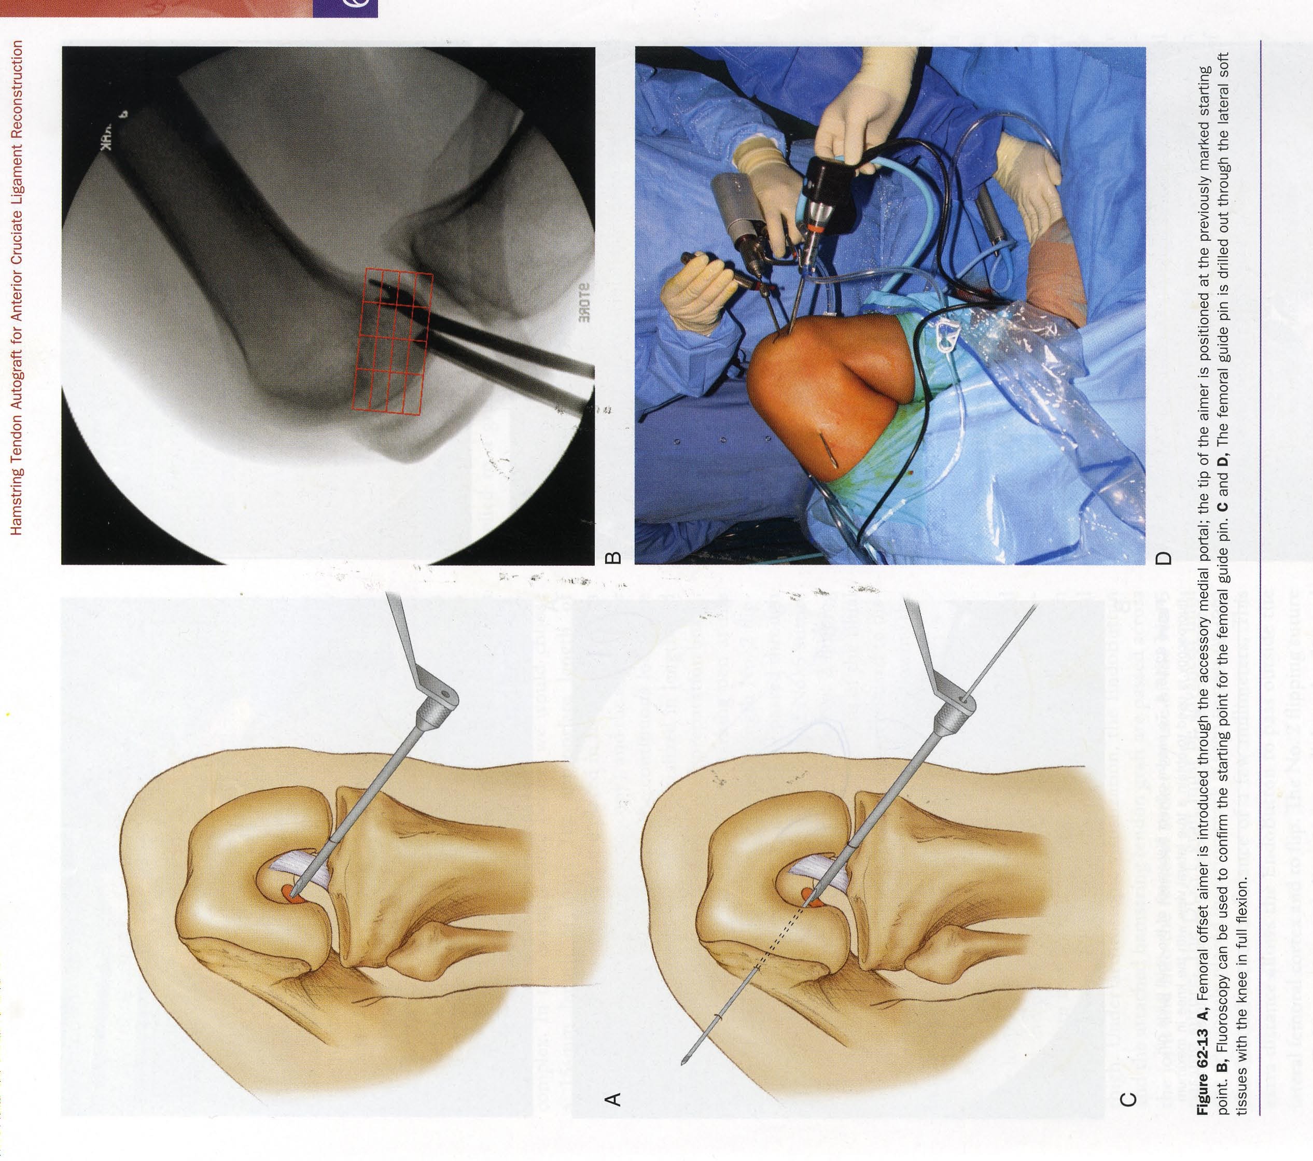

Slide 58
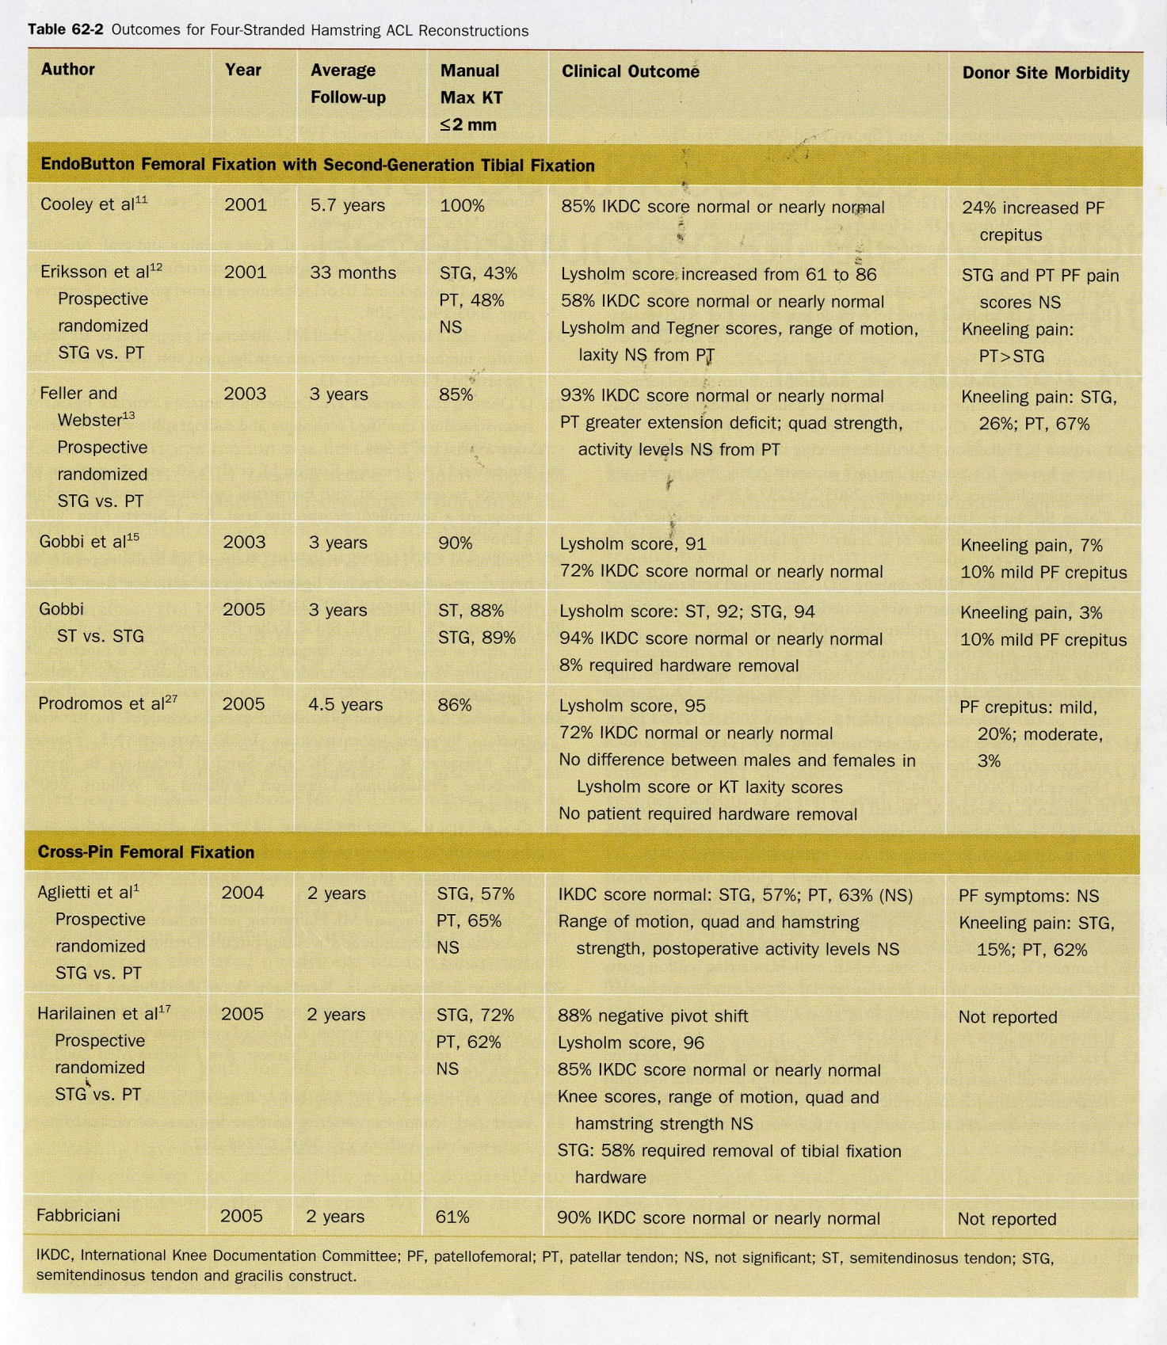

Slide 59
Loss of Extension After Reconstruction of the Anterior Cruciate Ligament J Am Acad Orthop Surg 1999;7:119-127
➢ The most common complication of anterior cruciate ligament (ACL) reconstruction
is loss of extension, which is often functionally worse for patients than their
preoperative instability.
Preventable surgical and nonsurgical etiologic factors : Accurate placement of the tibial tunnel, adequate notchplasty, and the routing of the femoral side of the graft are all critical factors. early range-of-motion therapy emphasizing immediate postoperative "hyperextension" and avoiding immobilization in flexion educes the rate of loss of extension.
Initial studies investigating the effect of acute versus chronic ACL reconstruction suggested that acute reconstruction is associated with a higher rate of loss of extension. However, the authors oftwo recent studies in which modern techniques were used have disputed this conclusion. It is likely that the loss of extension historically seen with acuteACL reconstructions was related to tibial tunnel placement and postoperativeimmobilization. It is possible that the timing of acute ACL reconstruction has less of an effect than originally postulated.
On the basis of the results of severalbiomechanical studies, it appears that ACL reconstruction may be performed with the knee in full extension during graft placement with excellent results and a very low rate of loss of extension.
Use of the descriptive term "loss ofextension" is preferred to the often misleading terms "arthrofibrosis" and "flexioncontracture."

Slide 60
Lachman’s test

Slide 61
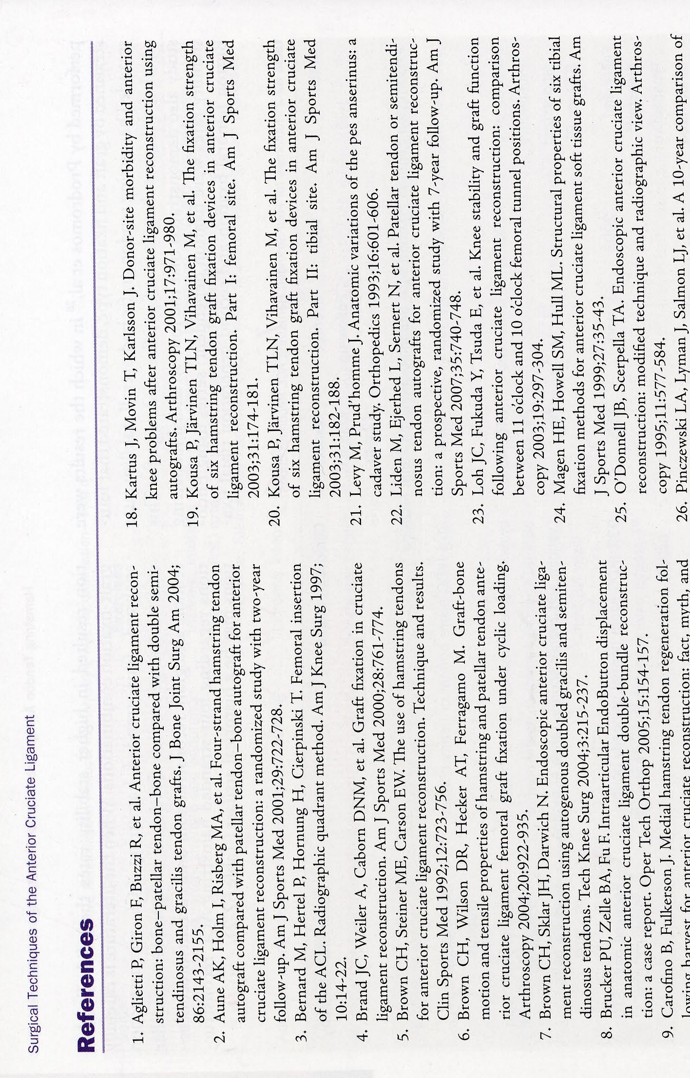

Slide 62
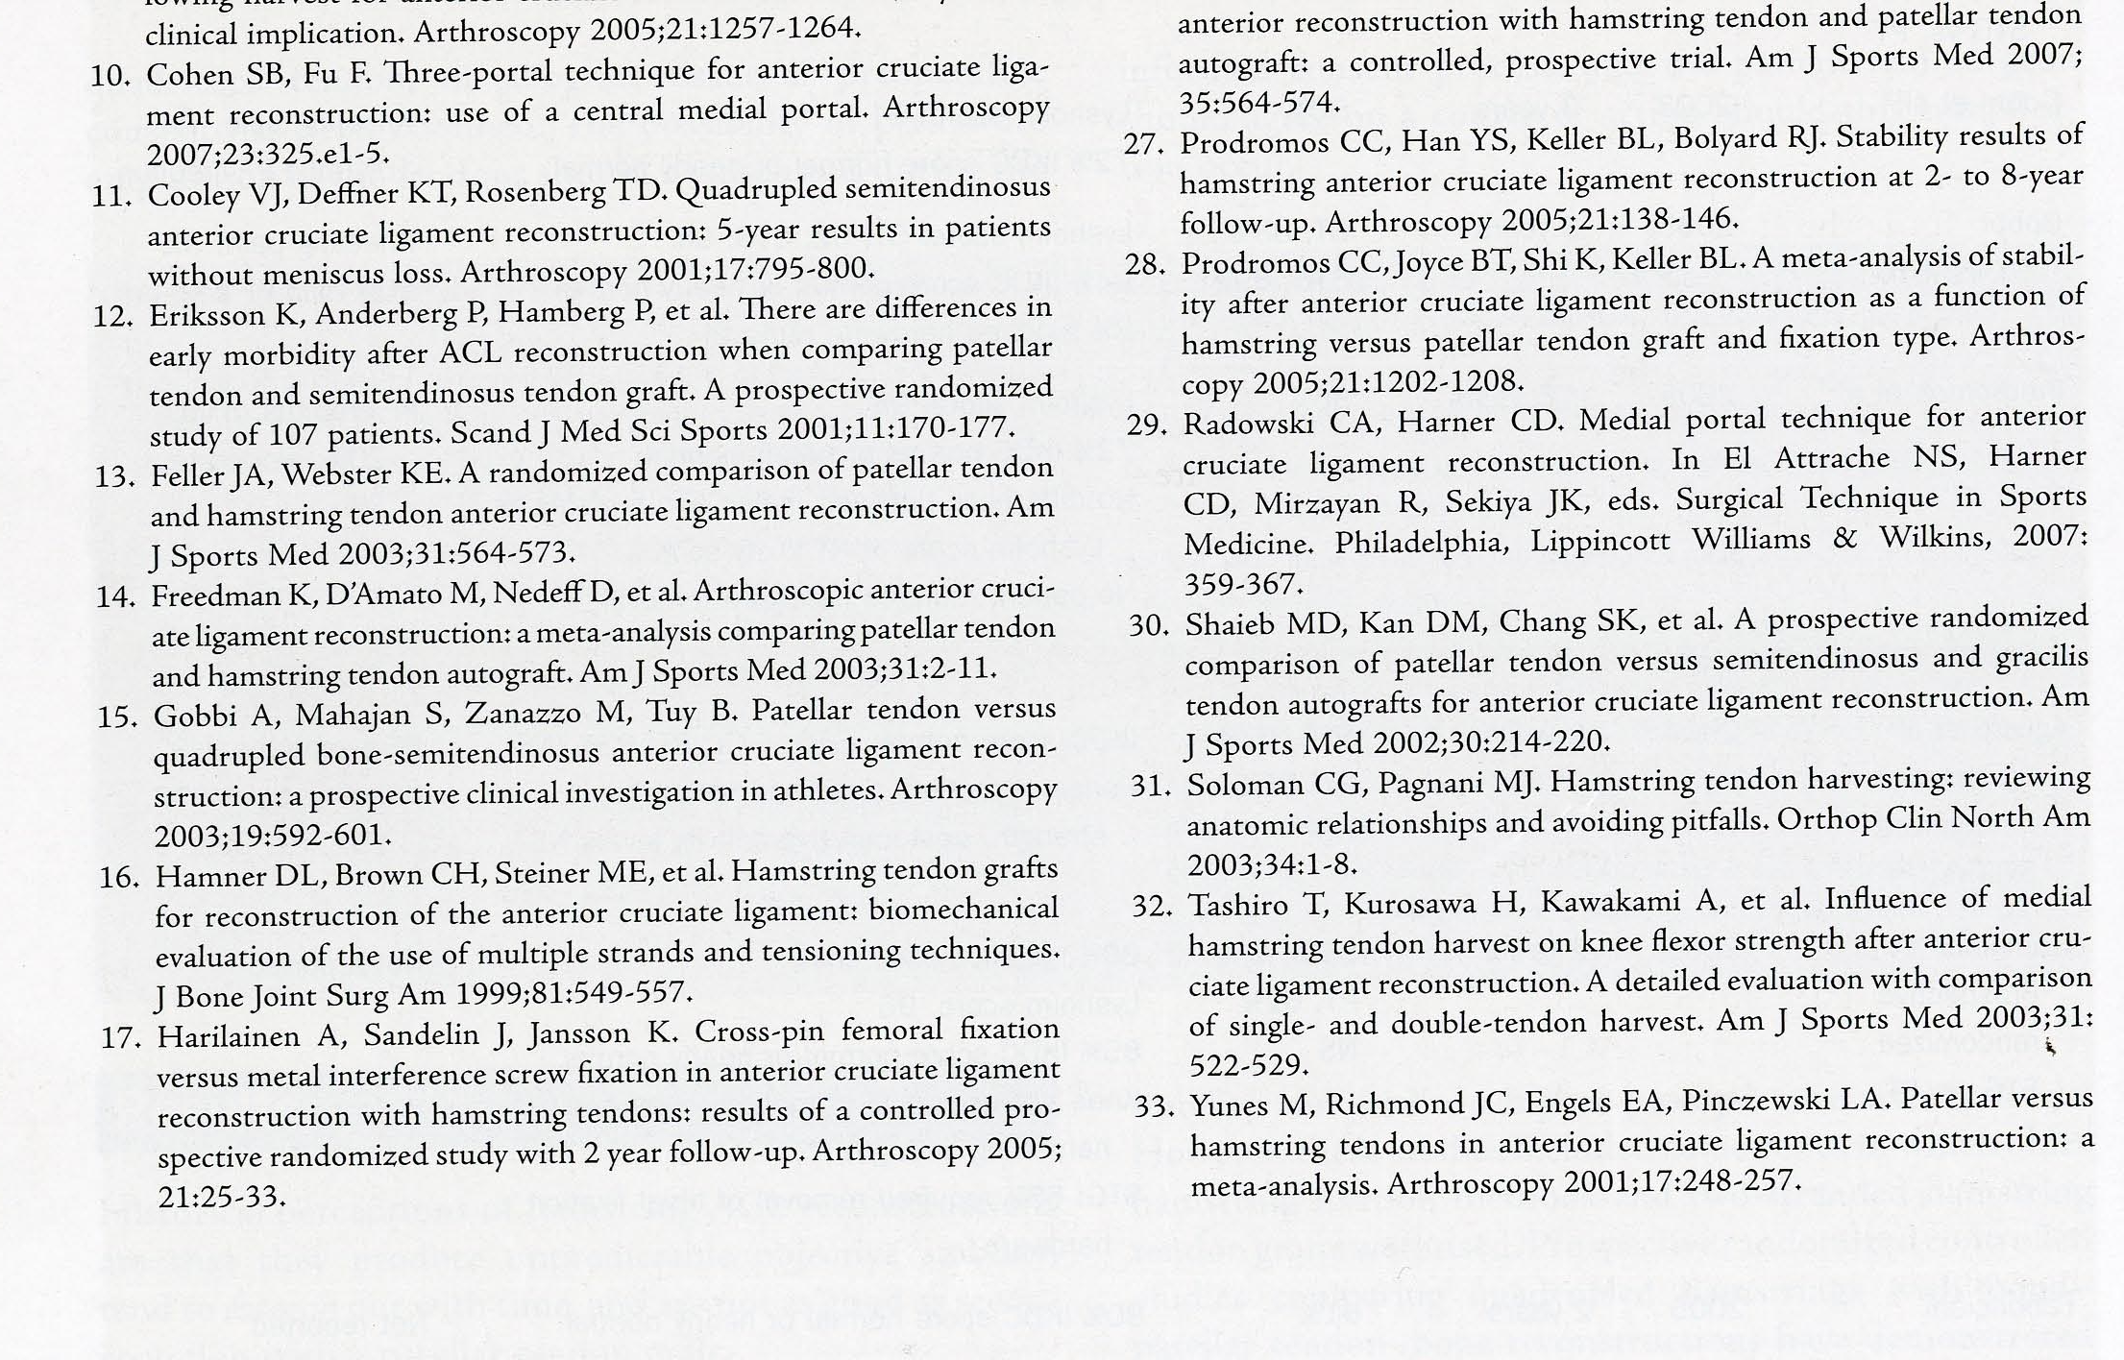

Slide 63
Return to Sport
When can I start playing
Who can and who should answer this question
Multifactorial:
●athlete’s health status
● type of injury
● type and level of sport
● evidence based risk factors for the healing tissue

Slide 64
Return to Sport
Successful and Safe return to sport
Definitions
Is a Successful return to sport the same as a Safe return?

Slide 65
Return to Sport
Injury severity
Definition – absence from sport (number of days) → hazardous
We need strict criteria when an athlete is mentally and physically ready for a safe return

Slide 66
Return to Sport
Level of sport
Type of sport (pivoting Vs non-pivoting)
Competitive Vs Recreational

Slide 67
Return to Sport
Evaluation
ACL reconstruction: Pts with good hop performance were more likely to return successfully to sport than pts with poor hop performance.
The side-to-side difference between legs
- muscle strength tests
- functional performance tests

Slide 68
Return to Sport
Limb symmetry index for muscle function (LSI)
▪No consensus
▪ A side-to-side difference of 90% has generally been used, but evidence based studies to support this are lacking.

Slide 69
Return to Sport
After ACL Reconstruction
The European Board of Sports Rehabilitation(EBSR) recommends for the sports medicine community to consider:
Pivoting, contact and competitive sports: the injured leg should be > 100% of the non injured (in both – knee flexor and Extensor strength) and also > 90% in terms of 2 maximum hop tests (vertical jump and the hop for distance) as well as one hop test demanding endurable hop capacity (triple jump, stair hop, side hop test.
Non pivoting, non contact and recreational sports: > 90% for both strength tests and >90% for hop performance in one of the hop tests

Slide 70
SPORTS score(Subjective Patient Outcome for Return to Sports
The SPORTS score
is a 1 item score that has been developed as an easy to use method to evaluate an athlete’s ability to return to sport
It is independent of the “level” of the sport activity (competitive Vs recreational)

Slide 71
SPORTS score(Subjective Patient Outcome for Return to Sports
The SPORTS score is built around the concepts:
The ability to perform the same sport with the same level of effort and training
The ability to perform the same level of performance
To do these in the absence or in spite of pain
Knee Surg Sports traumatol Arthrosc(2012-Feb) 20:256-261

Slide 72
POSTOPERATIVE REHABILITATION PROTOKOL FOR HAMSTRING ACL REHABILITATION
Goals
Phase I: Days 0-7
Control pain, inflammation, joint effusion, swelling
Full passive extension = opposite knee
Achieve 90 degrees flexion
Prevent Quadriceps shut down
Prevent heel cord contracture
Gait Training
Phase II: weeks 1-2
Control inflammation, pain, joint effusion, swelling
Maintain full symmetric extension
Achieve 100-125 degrees of flexion
Develop muscle control to be safely weaned off knee immobilizer and crutches
Protect Hamstring donor site
Exercises
Knee cryo/cuff thigh length TED stocking, elevation
Heel props, pull knee into hyperextension with elastic band
Wall slides , gravity assisted flexion, sitting at the edge of a table
El. M. stimulation, quad isometrics,Active ass ext 90 to 0 degrees
Ankle pumps, calf stretches with elastic band.
Wt bearing as tolerated with knee immobilizer and crutches; Meniscus repair and revision:↑25% BW/week, wean off crutches at end of week 4
Continue phase I exercises
Continue phase I exercises
Assisted flexion with use of opposite leg, wall slides, heel drags rolling stool
Continue phase I exercises, mini-squats, toe raises active extension 90-30 degrees.
Prevent sudden, forceful hamstring stretching with the knee and hip in extension, such as attempting to lean forward to put on socks and shoes or leaning forward to pick up an object off the floor.

Slide 73
POSTOPERATIVE REHABILITATION PROTOKOL FOR HAMSTRING ACL REHABILITATION
GOALS
Phase III: weeks 2-4
Maintain symmetric extension
Wean off knee immobilizer
Wean off crutches
Achieve 125-135 degrees of Flexion
Hamstring strengthening
Quadriceps strengthening
Hip strengthening
Proprioceptive training
Aerobic conditioning
Phase IV: weeks 4-6
Obtain full Flexion
Continue Quadriceps, Hamstring and hip strengthening
Proprioceptive training
Aerobic conditioning
EXERCISES
Heel props, prone heel hangs, lock knee out, lock knee out, “stand at attention”. Pts who fail to obtain symmetric extension splinting or a “dropout” cast.
Discard immobilizer when SL raises without a quad lag
One crutch with ability to bear 75% of BW. Discard crutches with full WB and ability to walk with normal heel-toe gait
Heel slides, sitting back on heels
Hamstring Isometric 0-90 degrees, pull rolling stool backward
Continue phase II exercises, mini squads with elastic band for resistance
Side-lying hip abduction, adjustable-angle hip machine
Balance board double leg stance.
Elliptical machine
Heel slides sitting back on heels
Mini squats, leg press 0-50 degrees, front step ups, stair master backward, proprioceptive neuromuscular facilitation
Toe raises, seated leg curl machine 0-90 degrees
Balance board double and single-leg stance, add ball throws and catches
Stationary bike(adjust to protect PF joint), elliptical machine pool exercises

Slide 74
POSTOPERATIVE REHABILITATION PROTOKOL FOR HAMSTRING ACL REHABILITATION
GOALS
Phase V: Week 6-12
Increase lower extremity strength and endurance
Advance proprioceptive and perturbation training
Phase VI: Weeks 12-16
Increase Quad and Hamstring strength
↑ hamstring strength at high flexion angles
Jogging and running
Crossover drills
EXERCISES
↑ intensity of phase IV exercises, high speed (300-360 degrees/sec), isokinetics, extension(90-30 d), flexion (0-90d), elliptical machine, stairmaster backward and forward, treadmill walking,pool exercises
intensity of phase IV exercises
↑ intensity of phase IV exercises,midrange(180-240 degrees/sec) isokinetics, extension(90-30 d) flexion(0-90)
Prone leg curls with elastic tubing and leg curl machine(90-120 degrees)
Treadmill jogging and running on low impact surface
Lateral step-over, carioca drills

Slide 75
POSTOPERATIVE REHABILITATION PROTOKOL FOR HAMSTRING ACL REHABILITATION
GOALS
Phase VI: weeks 16-24
Hard cutting and sports specific drills
Return to noncontact sports at 4-5 months
Return to full sports at 6 months(revisions, 9 months)
EXERCISES
Figure-of-eight, circle run, plyometrics, hopping, jumping, sprinting
Golf, tennis, biking, hiking

Slide 76
